Slide 1
Finding Unity and Making Decisions on Justice and Peace Priorities
LEYM Peace and Justice
Workshop 4/27/25

Slide 2
Introduction
Review Situation – Survey – Workshop #1
Today’s Topic: Finding Unity and Making Decisions on Justice and Peace Priorities
Overview Slide
Meeting Facilitation – Barriers and Breakthrough discussion #1
Making Decisions – Barriers and Breakthrough discussion #2
Summary and Gratitude

Slide 3
Situation: LEYM P&J Committee’s Meetings Survey
From our survey we learned that our Monthly Meetings are struggling with:
How to form a committee Friends want to join
How to develop committee work that is Spirit led when picking a social justice and peace issue for attention
How to sustain focused committee work when conflict arises
How to scale and resource according to the matters of concern
So, in this workshop, we took up these issues …

Slide 4
Background: The Work of Peace and Justice
Strong desire to stimulate Effective Peace and Justice Work in our Monthly Meetings where we can better …
1) identify an issue of concern (all issues matter - what is the most pressing need of the moment? Can we sense spirit leading?)
2) raise awareness of that issue to engage the Meeting (spirit - touch our hearts)
3) educate the Meeting on ways folks can participate (spirit - inform our minds)
4) advocate for Community change (spirit - engage our hands and feet)
5) collaborate with local, regional and national Organizations in direct action (spirit - empower our testimony)

Slide 5
Assessment: Needs Addressed 1st Workshop
• Workshop focused on stimulating effective peace and justice work in monthly meetings
• Fifteen participants in four breakout groups discussed challenges and solutions for peace committees
• Participants then explored barriers to forming/sustaining peace committees and brainstormed solutions
• Group agreed to reconvene on the 27th for follow-up discussion on “Finding Unity and Making Decisions” on J&P priorities

Slide 6
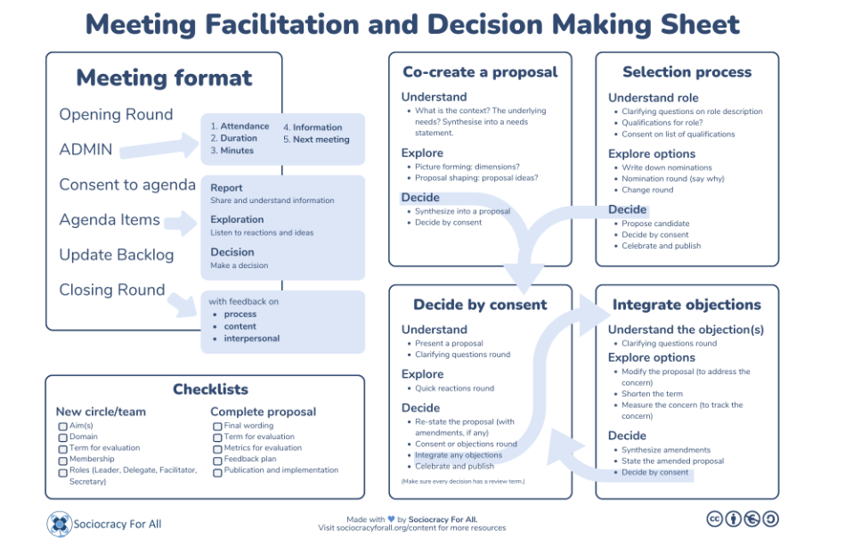
https://www.sociocracyforall.org/facilitation/#objections

Slide 7
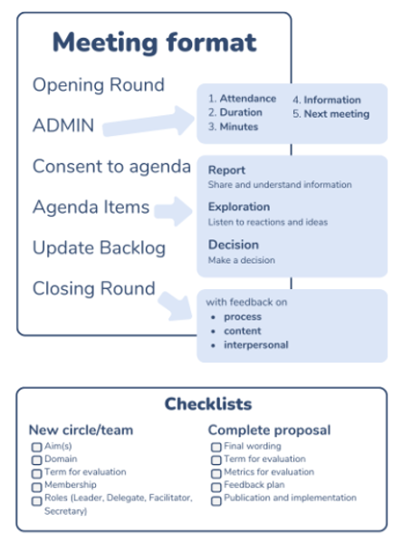
Meeting Facilitation Worksheet
1) Where do our committee meetings get hung up?
2) What might we do to open the way?
https://www.sociocracyforall.org/meeting-format/

Slide 10
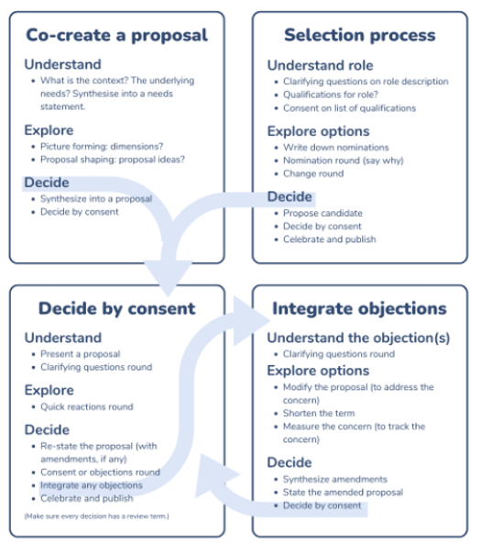
Decision Making Worksheet
Where do our proposals get hung up?
What might we do to open they way?
https://www.sociocracyforall.org/consent-decision-making/

Slide 12
Respecting both “Consent” and “Sense of the Meeting” Process
Committee Work seeks through intelligent assessment to identify needs and concerns; investigate possible opportunities for resolution; integrate thoughtful objections/alternatives; and by consent agree that an idea is good enough and safe enough to TEST or tryout for a period, with scheduled review for adjustment, adoption or abandonment based on spirit’s guidance through action. This is the formation process for proposals to the Monthly Meeting.
Meeting for Worship with Attention to Business seeks to discern the suitability of the committee recommendation, holding it in Light of Friend’s testimonies and Spirit’s leading through love and conscience. In this way, the Sense of the Meeting arises, and guidance is received through faith. This is the affirming process for proposals received by the Monthly Meeting.

Slide 13
Summary Suggestions
Functional Peace and Justice Work Groups / Committees don’t just “happen” – needs attention!
1) Form your workgroup from participants having spirit led passion to partner with one another for active peace testimony locally, regionally, nationally, globally
2) Balance personal interests with pressing needs the meeting might be concerned to address
3) Unify the workgroup using skilled sociocracy meeting leadership and facilitation
4) Decide by consent to test “good enough/safe enough” ideas, review outcomes, integrate objections to strengthen peace and justice proposals
5) Bring best work to the Meeting for consideration
Stay focused on THE task: Effective Peace and Justice Work in our Monthly Meetings …
1) identify an issue of concern (all issues matter - what is the most pressing need of the moment? Can we sense spirit leading?)
2) raise awareness of that issue to engage the Meeting (spirit - touch our hearts)
3) educate the Meeting on ways folks can participate (spirit - inform our minds)
4) advocate for Community change (spirit - engage our hands and feet)
5) collaborate with local, regional and national Organizations in direct action (spirit - empower our testimony)

Slide 14
Thank You!
The LEYM Peace and Justice Committee wants to acknowledge and thank for their kind help –
Phil Volk, Ann Arbor Friends – for being such a great example!
Brad Wade, Broadmead Friends – cohost and zoom meeting tech
Bill Warters, Birmingham Friends – seminar promotion

